Slide 1
The strategic low dose program of the Canadian nuclear utilities - addressing the worries and concerns of the public Nick Priest October 2018

Slide 2
COG Workshop on Long Term R&D Strategic Plan
Toronto January 20-21st, 2015
Agenda to identify priority areas for action within a COG Strategic R&D Program
Eight priority areas identified
including: A need for a low-dose
radiation research program to produce a better informed public.
Decision made to start program

Slide 3
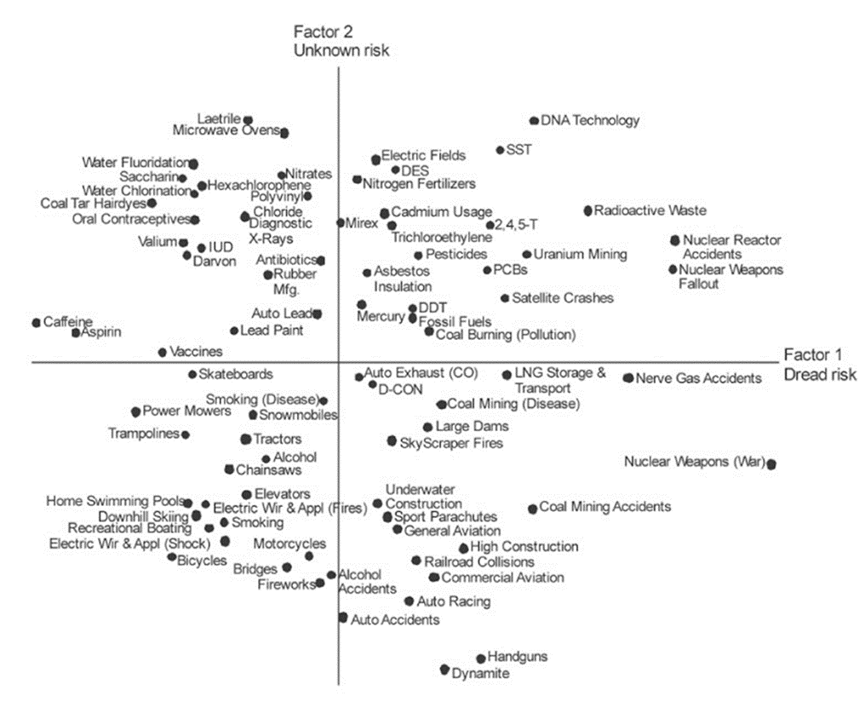
Radiation has an image problem!
Most feared, Public think radiation risk unknown and afraid it will likely cause cancer and genetic disease at any dose.
Public have an unrealistic perception of risk that impacts upon acceptability of nuclear and radiological applications
From Slovic et al., 1981

Slide 4
New technology health communication stages (Lave et al 1989)
People don’t care - new and exciting, few worries and messages about safety
Trust the experts - worries emerge and industry forced to respond, but risks poorly understood. Complex and public should trust
Talk louder stage – frequent debates with opposing views. Public left confused and distrustful of experts
Tell them what they should know – industry deluge of facts and figures selected to support their position. Public believe experts evasive and patronising and ignore public concerns
Tell them what they want to know – problematic because experts not tuned into public worries. “Communication” one-way and commonly fails at this stage
Deal with perceptions – starts with public perceptions, moves to objective appraisal of health risks and how risks should be balanced against benefits of technology

Slide 5
Bottom-up, public-facing program
Addressing Public Concerns about Their Exposure to Low Doses of Anthropogenic Radiation
Multi-year ongoing within framework of approved roadmap
Overseen by an independent committee
Agreed /planned Participants
Canadian Nuclear Laboratory (CNL)
University of Saskatchewan
University of Regina
University of Ottawa & Ottawa Hospital Research Institute
University of Ontario Institute of Technology
Health Canada
Statistics Canada

Slide 6
Program characteristics
The program is industry-funded, but is being conducted independently – it will not promote nuclear power
Driven by public worries and concerns about the effects of anthropogenic, low-dose radiation (LDR)
Respond to all concerns and undertake research projects to address these concerns
Seek collaboration /cooperation leverage (e.g. through NEA NEST and other programs)
Interact with the sources of public information to advise the public of findings
It is intended that the work should reduce concerns in Canada by providing accurate and unbiased information for decision making

Slide 7
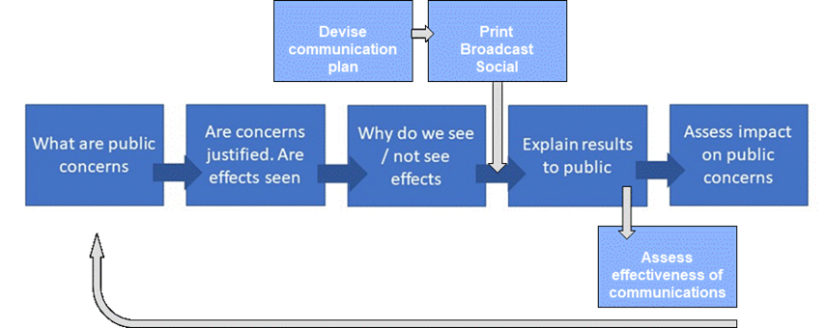
Program logic

Slide 8
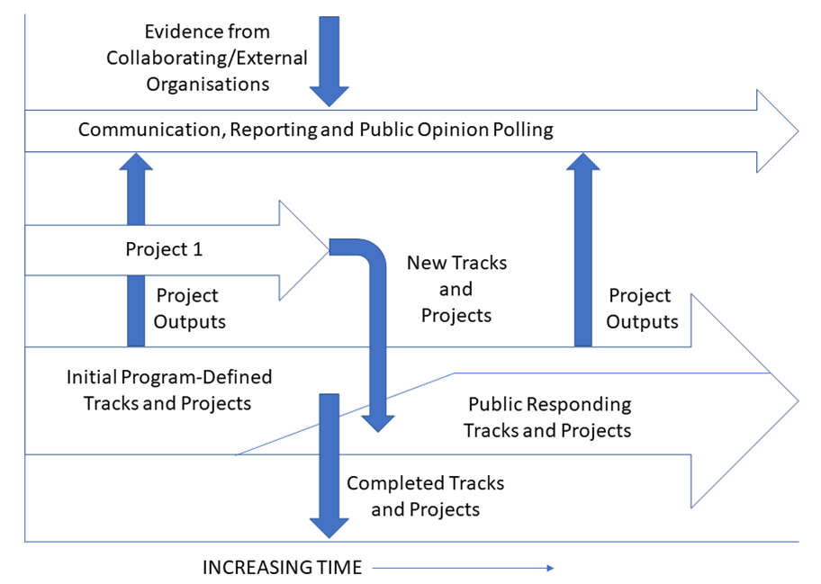
How it will work
Public concerns

Slide 9
Start-up projects
Based on published social science data
Hazard poorly understood
Population exposed and at risk
Look at external γ and X radiation
Examine effects below 100mGy
Mostly around 1 →10mGy (acute and protracted)
Utilize existing Canadian research capabilities
Embrace both social and physical sciences
Current budget approximately $1.2M+/y (most to universities)

Slide 10
Priming social science project
Centre for the Study of Science and Innovation Policy, University of Saskatchewan and University of Regina
The influence of social learning and attitudes on the perception of risk from low dose radiation.
What are the concerns
Why public has concerns
Importance gender, age, domicile, etc.
Perceptions northern communities
Effectiveness of communications
Industry, experts, Government, conventional media, social media
What research is needed

Slide 11
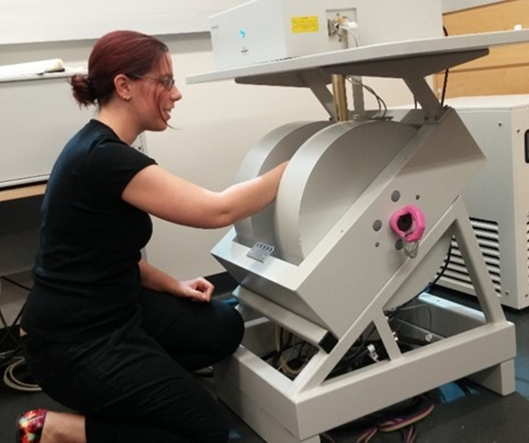
Population-based projects
Objectives:
Incremental doses to public living / working close to Canadian NPP’s
Evidence for health detriment (all causes of death and longevity)
Projects:
Accumulated dose in teeth
using ESR, Univ. Ontario Inst. Tech.
Epidemiology. Health effects in
exposed Canadian NPP and health
workers. Univ. Saskatchewan,
Health Canada, Statistics Canada

Slide 12
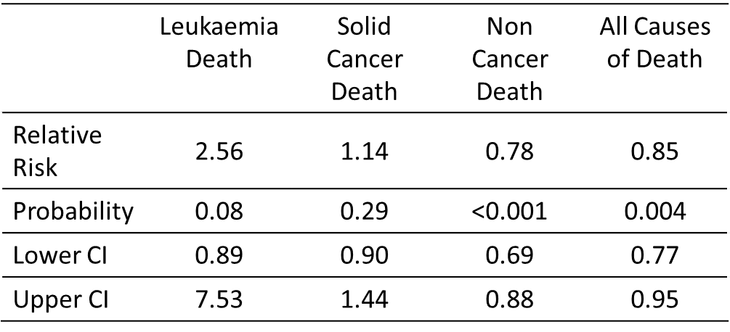
²²⁴Ra ankylosing spondylitis patients
Skeletal Dose .5Gy, CED 3Sv

Slide 13
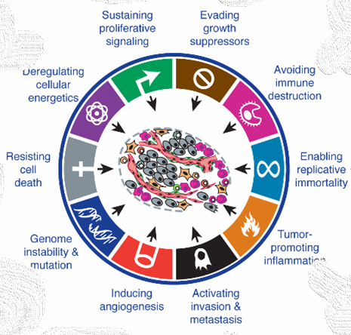
Radiobiology projects (CNL & uOttawa)
Objective:
To determine effect of LDR on cancer induction and progression
Effects of LDR on cell responses and tissue systems and the potential for disease.
8 Projects:
6 cancer related and 2 non-cancer projects

Slide 14


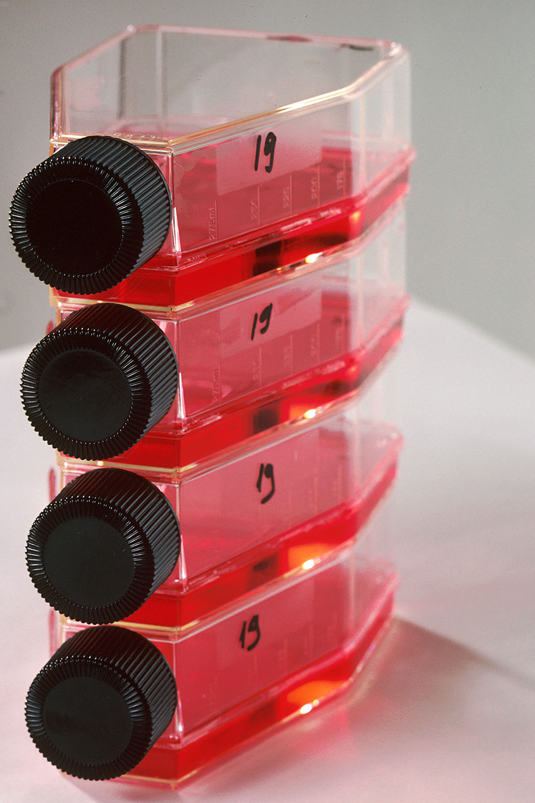
Leveraging to maximize “bangs for bucks”
Collaboration and cooperation with other programs – NEA initiative
Matched government funding (Canadian research councils)
Planned participation in NEA NEST program
Linkage of initial radiobiology projects to projects funded (~$7M/y) by the Canadian Federal Science & Technology program
MOSTLY CNL
Federal project studies
Surplus carcass
and tissues
Our project
studies
MOSTLY uOTTAWA

